Slide 1
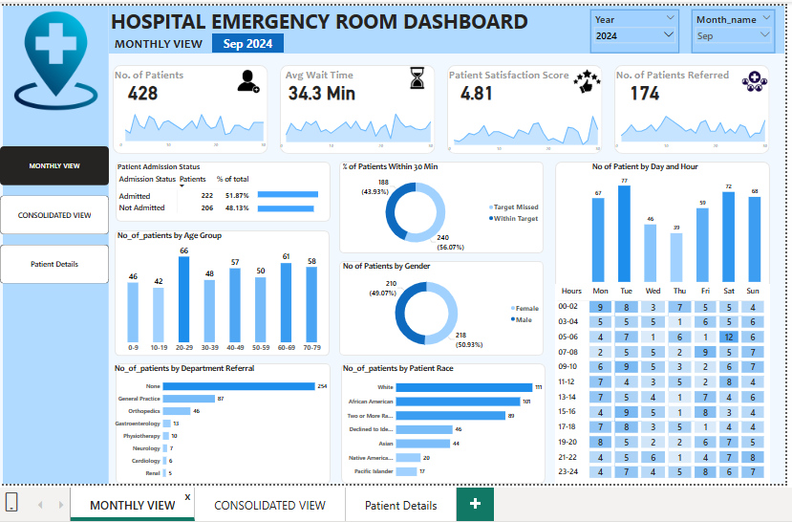
POWER BI DASHBOARD

Slide 2
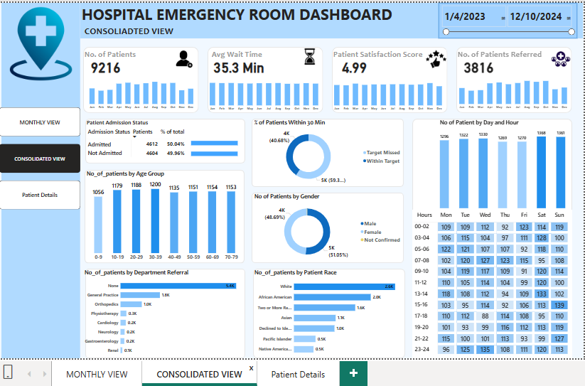
POWER BI DASHBOARD

Slide 3
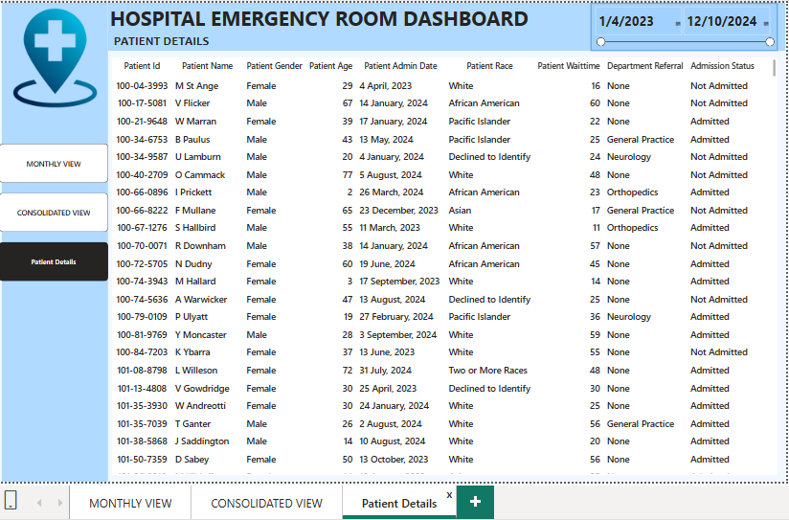
POWER BI DASHBOARD

